Slide 1
Faculty of Social Science
Ruhr-University Bochum

Slide 2
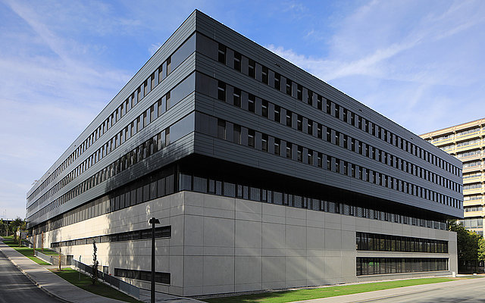
Faculty of Social Science, Ruhr-University Bochum: structure & numbers
7 Teaching & Research Areas
Sociology
Political Science
Social Economics / Social Policy
Social Psychology / Social Anthropology
Gender Studies
Social Science Didactics
Faculty of Social Science
Teaching Staff
Professors: 18
Researchers: 43
Numerous lecturers
Students
2.500

Slide 3
Faculty of Social Science, Ruhr-University Bochum: Programs
Bachelor of Arts/Undergraduate degrees
B.A. „Social Science“
B.A. „Culture, Individual, and Society“ (2-subject-model)
B.A. „Politics, Economics, and Society“(2-subject-model)
Master of Arts/Master degrees
M.A. Social Science with the following study programmes:
„Management and Regulation of Work, Economy and Organisation“ (Double Degree Option Puebla, Mexico)
„Health Care Systems and Health Care Economics“
„Urban and Regional Planning“
„Globalisation, Transnationalisation, and Governance“ (Double Degree Option Wroclaw, Poland)
„Culture and Person“
„Methods of Social Research”
M.Ed. „Social Science”
Master of Arts/ Master degrees in cooperation with other faculties
M.A. International Gender Studies (Double Degree Option Graz, Austria)
M.A. Gender Studies (2-subject model)
M.A. European Culture and Economy
M.A. Ethics, Law and Politics

Slide 4
Faculty of Social Science, Ruhr-University Bochum: Modules
Bachelor of Arts
Social Economics
Sociology
Political Science
Cultural Psychology and Social Anthropology
Statistics
Empirical Social Research
Economic and Social Policy
Social Structure and Social Change
Political System of Germany
Sociology of Labour, Economy and Organisations
Comparative Politics
Social and Cultural Psychology
Labour
Internationalisation
International Relations
Social and Cultural Anthropology
Political System and Economic Policy
Urban and Regional Development
International Structures and Processes
Cultural Change and Migration
Methods of Data Collection and Analysis
European Union
Social Science Education
Master of Arts
Social Science Theories
Qualitative Methods
Methods and Statistics
Labour and Organisation
Regulation of Employment and Participation
Business Locations and Fields of Economy
Health Economics and Health Policy
Health and Society
Public Health
Urban and Regional Research
Local and Regional Politics
Area and Development
Internationalisation and Transnationalisation
International Institutions and Processes
Europeanisation, Democracy and Governance
Cultural Psychology, Cultural and Social Theory
Culture and Gender
Interculturality
Advanced Data Analysis
Methods of Empirical Social Research
Methodological Aspects of Data Analysis
Didactics, Evaluation and Teaching Research
Fields of Social Science Teaching
Didactical Transformation

Slide 5
Faculty of Social Science, Ruhr-University Bochum: Research
Research Areas
Textures of Gobalisation: Breaks, Tensions and Governance
Governance as multi-lateral management of economic globalisation and shaping by societal ideas and interests
The challenge of governance in complex multi-level systems
Tensions and contradictions in textures of globalisation and their economics and societal consequences
Interdependencies of social structures and mobilisation in transnational arenas
Interweavings and transformations of global, national and local systems of knowledge and norms
Public Sector and Government Action: Causes, Effects and Change
Public sector modernisation
Health economy and public health
Social policy and distribution
Family and family policy
Labour and Social Structure: Dynamics, Diversity and Cohesion
Forms and interdepencies in the organisation of labour and value chains
Pluralisation of life forms and gender
New forms of social unjustice and social ties
Regulation of labour and change of labour relations
Culture, Identity and Gender: Negotiations and Re-Formations
Cultural and social constitution, reproduction and transformation of personal and collective identities
Relations between individuals and groups
Cultural exchange: intercultural communication, cooperation and co-existence
Influence of media and technology on transformative learning
Change of gender relations
Relationship of collective, socio-cultural forms of knowledge and action and individual forms of subjectivity

Slide 6
Faculty of Social Science, Ruhr-University Bochum: Exchange
Teaching
Erasmus
Double Degrees
Benemérita Universidad Autónoma de Puebla (Mexcico)
Uniwersytet Wroclawski, Wrocław (Poland)
Karl-Franzens-Universität Graz (Austria)
Staff Exchange / Teaching cooperation
Colegio de la Frontera Norte, Tijuana (Mexico)
Colegio de México, Mexiko City (Mexico)
Benemérita Universidad Autónoma de Puebla (Mexcico)
“Digital Network University” (Goethe-Institute Moscow) with universities in Ukraine, Georgia and Russia
UNIC-Cooperations (e.g. "What is transnational in migration?
The example of UNIC-Postindustrial Cities” WS 21/22)
Universiteit Antwerpen (Belgium) Université de Liège (Belgium) University of Plovdiv (Bulgaria) Tallinn University of Technology (Estonia) University of Helsinki (Finland) Université de Tours (France) Università degli Studi di Padova (Italy) Università di Bologna (Italy) Università degli Studi di Urbino (Italy) Università degli Studi di Teramo (Italy) University of Zagreb (Kroatia) Latvijas Universitate, Riga (Latvia) Vilnius University (Lithuania) Université de Luxembourg (Luxembourg) Radboud Universiteit, Nijmegen (The Netherlands) | Radboud Universiteit, Nijmegen (The Netherlands) Erasmus University College, Rotterdam (The Netherlands) Uniwersytet Wroclawski, Wrocław (Poland) Uniwersytet Jagiellonski, Krakau (Poland) Universidade de Coimbra, Coimbra (Portugal) Universitatea Babeș-Bolyai, Cluj (Romania) Universität Basel (Switzerland) Universidad Complutense de Madrid (Spain) Universidad de Oviedo (Spain) Univerzita Karlova, Prag (Czech Republic) Koç University, Istanbul (Turkey) Akdeniz Üniversitesti, Antalya (Turkey) Middle East Technical University, Ankara (Turkey) Istanbul Üniversitesi (Turkey) Eötvös University, Budapest (Ungarn)

Slide 7
Faculty of Social Science, Ruhr-University Bochum: open online courses 2022
Migration and transnational relations in Postindustrial Cities
Varieties of Capitalism, societies and politics in contemporary Latin America

